Slide 1
CPSC 597 Midterm Project Presentation
A Web Application Integrating an AI-Based Intrusion Detection System
for Network Traffic Analysis
Vinh Tran

Slide 2
Contents
Achievements
Dataset
Machine Learning Models
Server Development
Client Development
Future Plans
Demo/ Demonstration

Slide 3
1. Dataset - Overview
Name: UNSW-NB15 Dataset
Author: Dr. Nour Moustafa from UNSW Canberra, Sydney
Contain raw network traffic data that are split into two different files
‘UNSW_NB15_training-set.csv’: have 175,342 records
‘UNSW_NB15_testing-set.csv’: have 82,332 records
Have totally 49 features and 9 types of attacks (e.g., Fuzzers, Analysis, Backdoors, DoS, etc.)

Slide 4
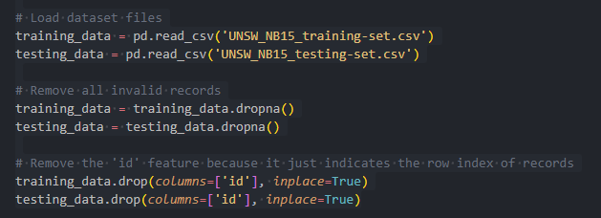
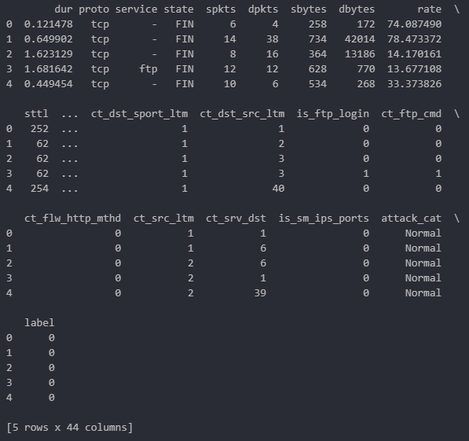
1. Dataset - Preprocessing
- Dropped 5 features, such as “id”, “srcip”, “sport”, “dstip”, “dsport”.

Slide 5
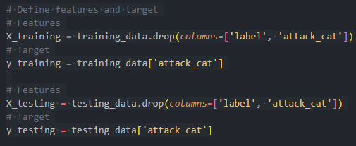

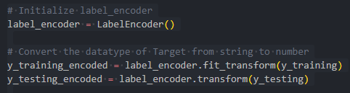
1. Dataset - Preprocessing

Slide 6
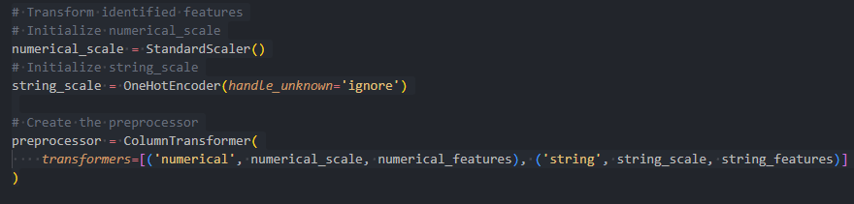
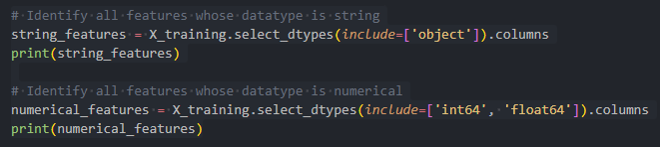
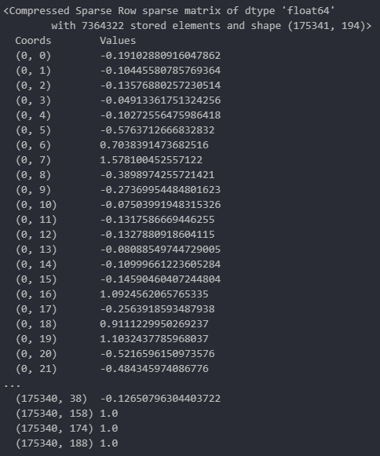
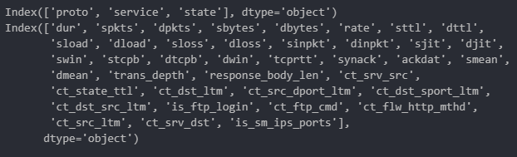
1. Dataset - Preprocessing

Slide 7
1. Machine Learning Models - Training
UNSW_NB15_training-set.csv
UNSW_NB15_testing-set.csv
Supervised Learning Models
Training
Predict
Features_testing
Target_testing
Features_training
Target_training
Predictions

Slide 8
1. Machine Learning Models - Comparison
Models | Accuracy Score
K-NN | 0.699 or 69.9%
Decision Tree | 0.698 or 69.8%
Support Vector Machine | 0.68 or 68.0%
Random Forest | 0.75 or 75.0%
XGBoost | 0.766 or 76.6%

Slide 9
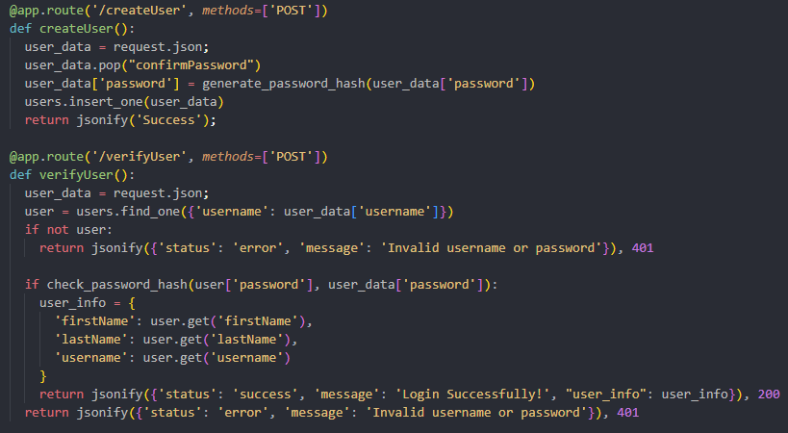

1. Server Development

Slide 10
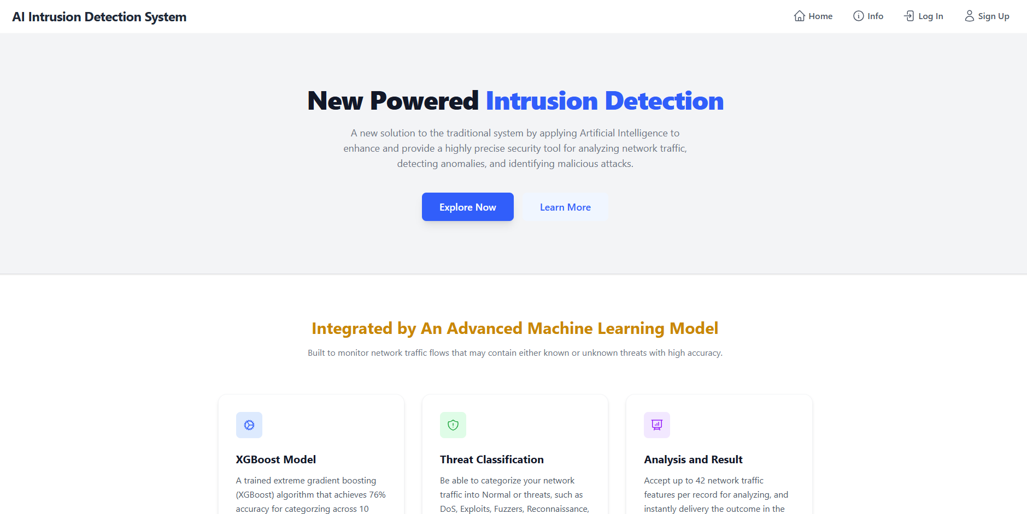
1. Client Development

Slide 11
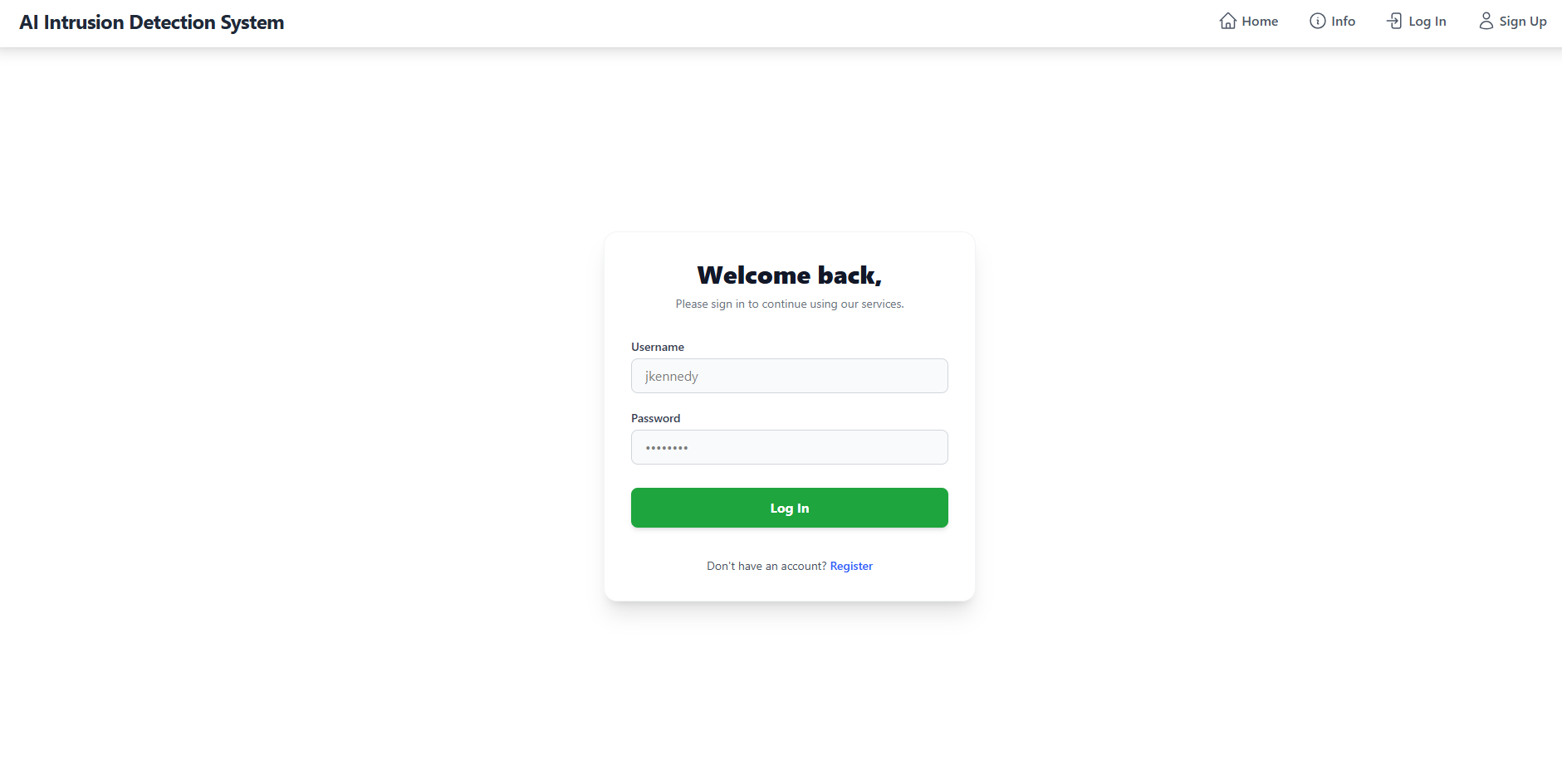
1. Client Development

Slide 12
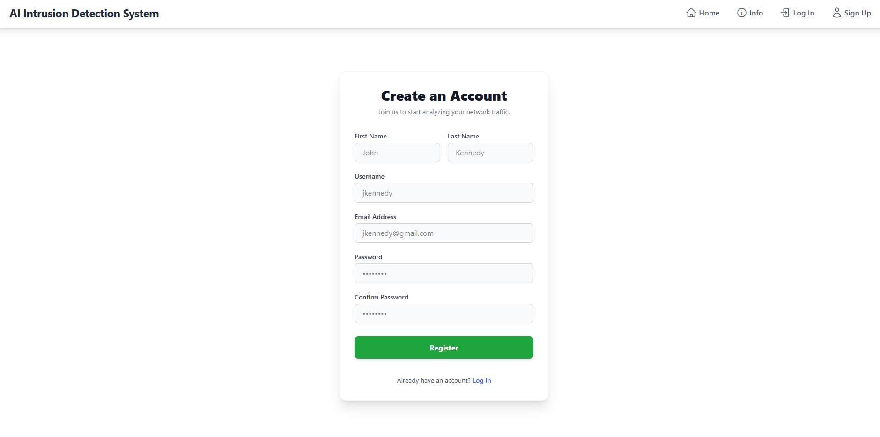
1. Client Development

Slide 13
2. Future Plans
Design the user interface for the Info page
Implement the logic, notifications, and warnings that are popped up to users when they interact with the application
Implement the logic for the server side to ensure that the account has unique username and email
Implement the logic to display the user interface after a user successfully logs in to the application
Develop another API that accepts and stores the files uploaded by users

Slide 14
3. Demo/ Demonstration

Slide 15
Reference
Moustafa, Nour, and Jill Slay. "UNSW-NB15: a comprehensive data set for network intrusion detection systems (UNSW-NB15 network data set)." Military Communications and Information Systems Conference (MilCIS), 2015. IEEE, 2015.
Moustafa, Nour, and Jill Slay. "The evaluation of Network Anomaly Detection Systems: Statistical analysis of the UNSW-NB15 dataset and the comparison with the KDD99 dataset." Information Security Journal: A Global Perspective (2016): 1-14.
Moustafa, Nour, et al. "Novel geometric area analysis technique for anomaly detection using trapezoidal area estimation on large-scale networks." IEEE Transactions on Big Data (2017).
Moustafa, Nour, et al. "Big data analytics for intrusion detection system: statistical decision-making using finite dirichlet mixture models." Data Analytics and Decision Support for Cybersecurity. Springer, Cham, 2017. 127-156.
Sarhan, Mohanad, Siamak Layeghy, Nour Moustafa, and Marius Portmann. NetFlow Datasets for Machine Learning-Based Network Intrusion Detection Systems. In Big Data Technologies and Applications: 10th EAI International Conference, BDTA 2020, and 13th EAI International Conference on Wireless Internet, WiCON 2020, Virtual Event, December 11, 2020, Proceedings (p. 117). Springer Nature.

